Slide 1
Testing Console I/O
Java Development 2021
Cody Henrichsen

Slide 2
Testing
Console based testing is not normally something I do in class but I saw the need to mass check student code responses for the early projects.
This will make it easier to have students check their own work as they work on completing the project
This is accomplished be reassigning the Systems in and out streams

Slide 3
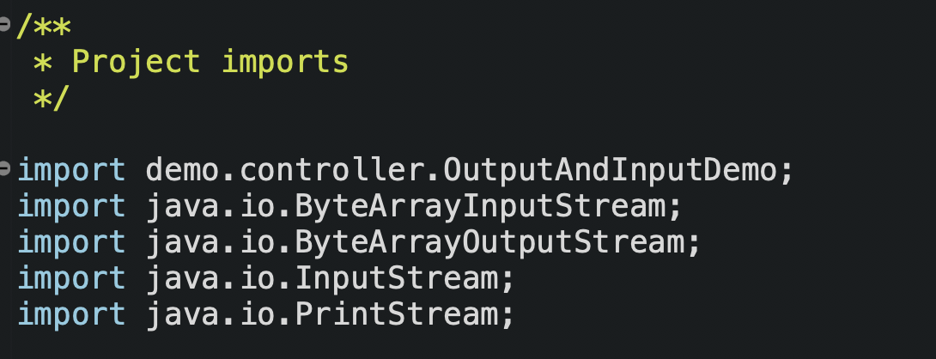
Testing Structure: Imports

Slide 4
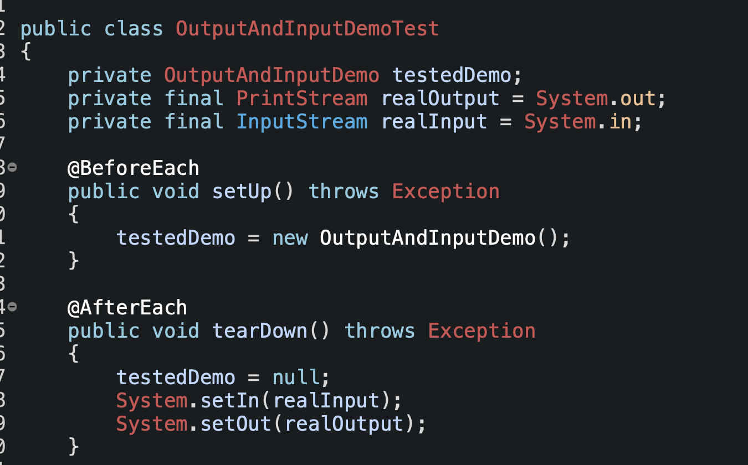
Testing Structure: Framework

Slide 5
Output Testing
To test the output provided by a method you just need to know what should be coming from the method and build a String that matches
Create a ByteArrayOutputStream and send it as the parameter to initialize a PrintStream, setting it as the output for System
Run the method that generates the output
Assign the output streams toString() to a String variable
Use the assertEquals to verify the output and the expected results match
Proper testing would repeat with multiple values

Slide 6
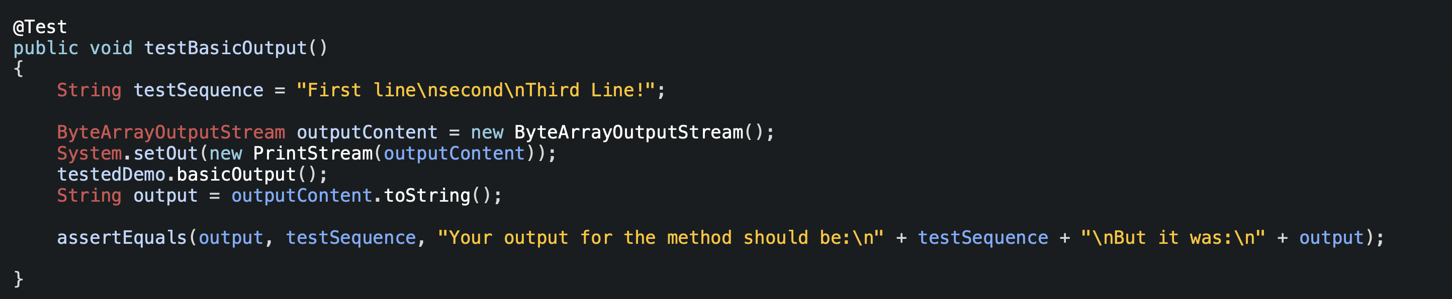
Output Testing Sample

Slide 7
Input Testing
First build an input String and initialize a ByteInputStream from the getBytes of the String
Set the stream as the System input
Re-initialize the tested object since the Scanner is initialized in the constructor
Run the method that uses the input
Assert the output matches appropriately
Proper testing would repeat with multiple values

Slide 8
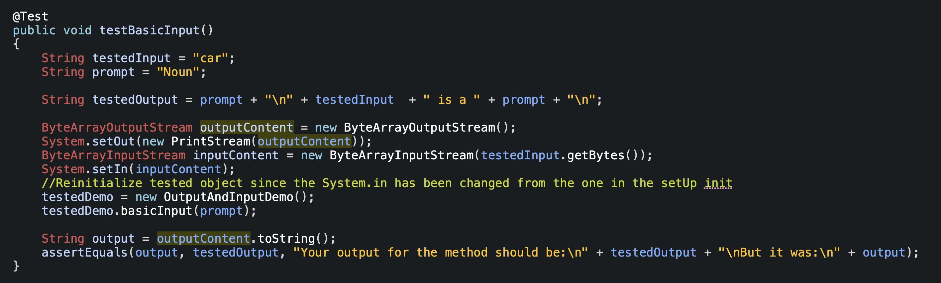
Input Testing Sample

Slide 9
Conversation Testing
To test a conversation based method you will need to build the responses in advance as a String and then set the bytes of that String to the source for the InputStream and then tell the System that that is now the stream for System.in
I recommend keeping these fairly simple as it will bloat easily. You will want to make sure your students understand the impact that a call to .next()/nextInt()/nextDouble() have compared to a call to .nextLine()
Remember to end with a \n if your statements are based on println

Slide 10
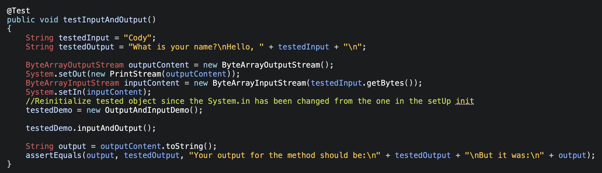
Basic Input and Output sample

Slide 11
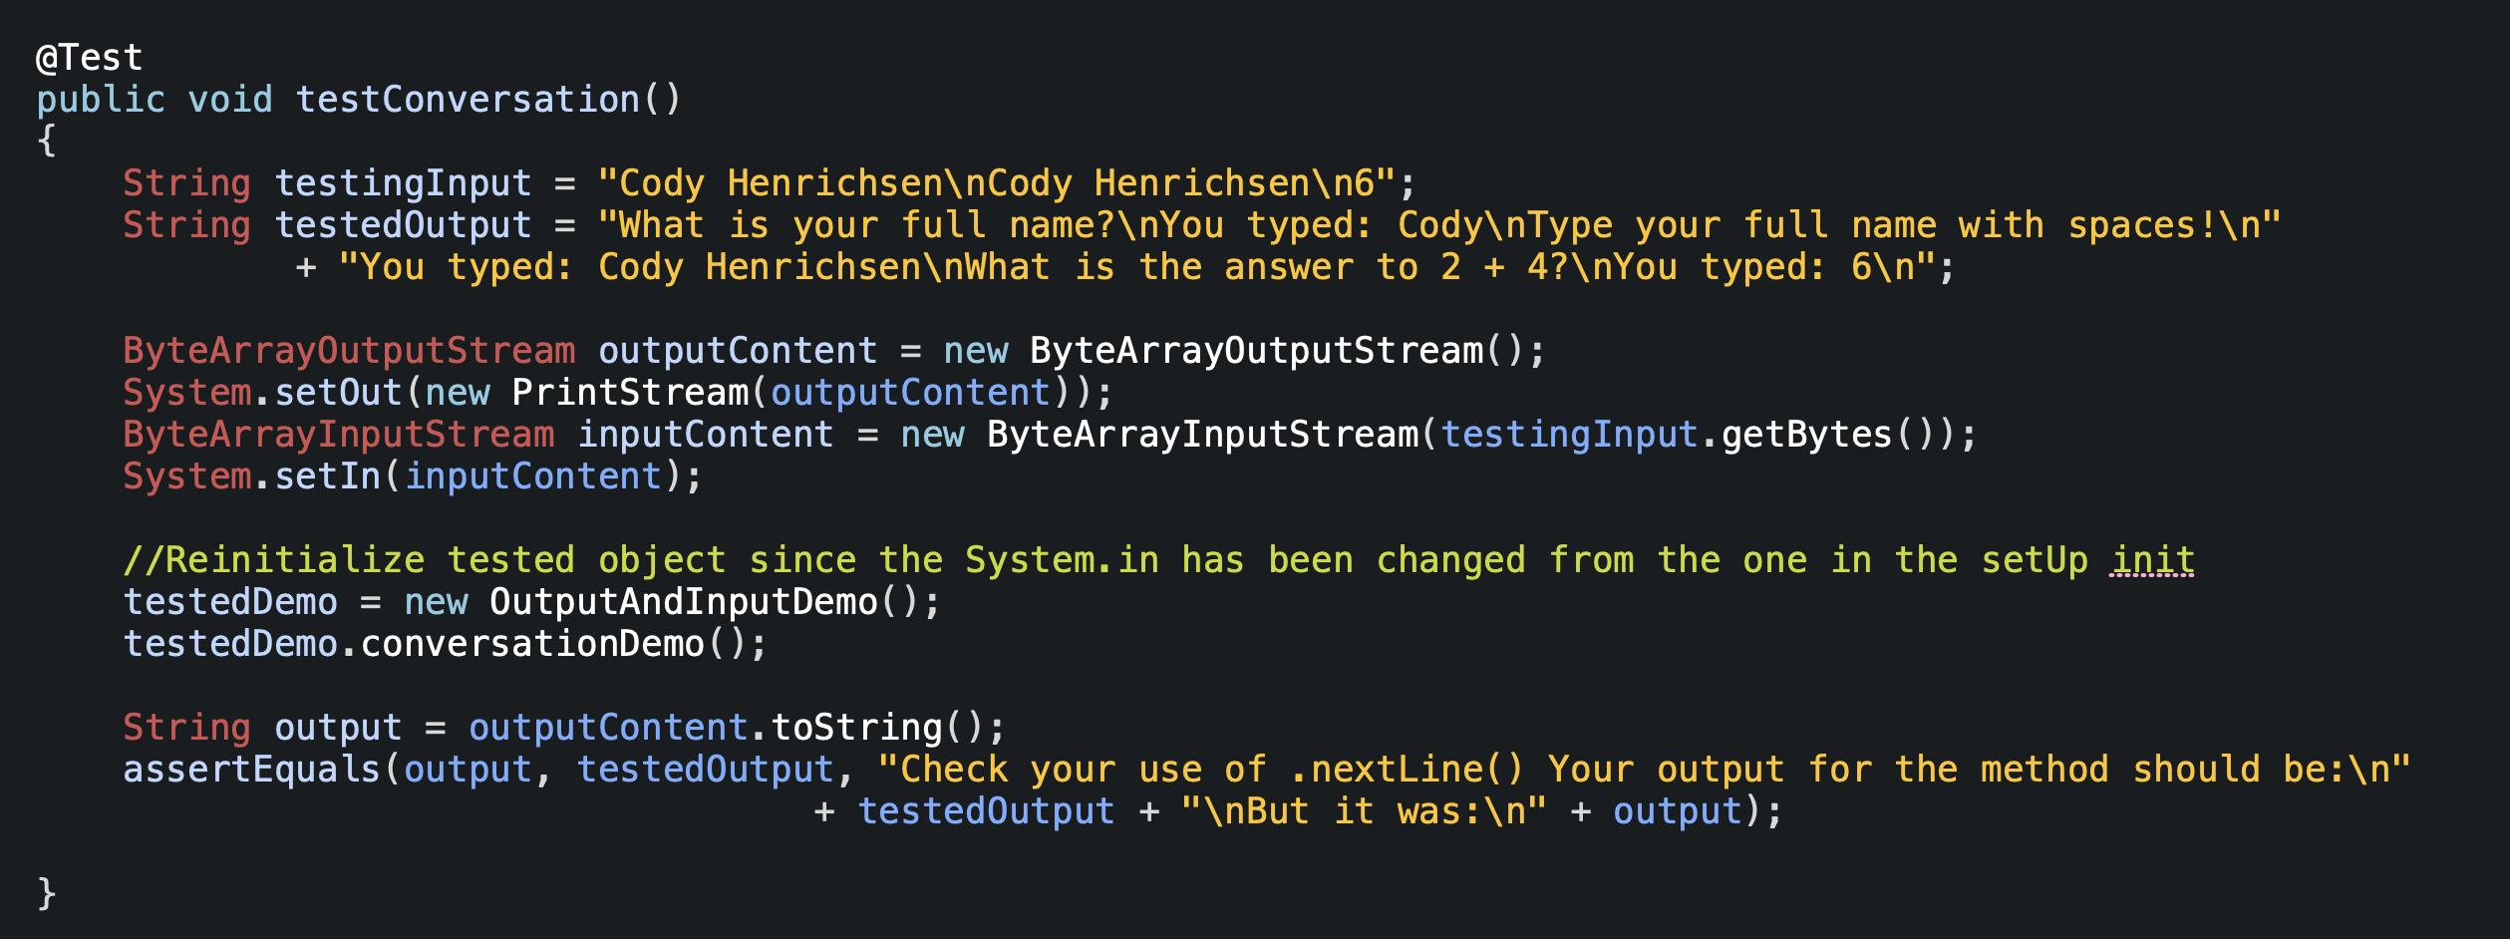
Conversation Testing Sample

